Slide 1

Sentiment Analysis
M. Narasimha Rao - AP20110010017
B. Jayanth - AP20110010049
G. Harsha Vardhan - AP20110010056
E. Vara Siddha Vignesh – AP20110010058

Slide 2

Outline
Introduction
Need of Sentiment Analysis
Approach for Sentiment Analysis
Implementation
Advantages
Conclusion

Slide 3
What is Sentiment Analysis
Sentiments are feelings, opinions, emotions, likes/dislikes ,good/bad.
Sentiment Analysis is a Natural Language Processing and Information Extraction task that aims to obtain writer's feeling expressed in positive or negative comments, questions and request, by analyzing a large numbers of documents.
Sentiment Analysis is a study of human behavior in which we extract user opinion and emotion from plain text.
Sentiment Analysis is also known as Opinion Mining.

Slide 4
What is Sentiment Analysis
It is a task of identifying whether the opinion expressed in a text is positive or negative.
Automatically extracting opinions, emotions and sentiments in text
Language-independent technology that understand the meaning of the text.
It identifies the opinion or attitude that a person has towards a topic.

Slide 5
Example
User's Opinions:
Jayanth: It's a great movie (Positive statement)
Vardhan: Nah!! I didn't like it at all (Negative statement)
Vignesh: The new Avatar movie is awesome..!!!(Positive statement)
Polarity:
Positive
Negative

Slide 6
Need of Sentiment Analysis
Sentiment Analysis to improve your customer service
Sentiment Analysis to boost your product and services
Do better in marketing campaigns
Monitor your brand perception
Track the sentiments in real-time

Slide 7
Approach
NLP(Natural Language Processing)
Use semantics to understand the language.
Machine Learning
Don't have to understand the meaning
Uses classifiers such as Naïve Byes, Logistic Regeression.

Slide 8
Naïve Bayes
The Naive Bayes algorithm is a supervised machine learning algorithm based on the Bayes’ theorem. It is a probabilistic classifier that is often used in NLP tasks like sentiment analysis.
Advantages of working with NB algorithm are:
Requires a small amount of training data to learn the parameters Can be trained relatively fast compared to sophisticated models
The main disadvantage of NB Algorithm is:
It’s a decent classifier but a bad estimator It works well with discrete values but won’t work with continuous values

Slide 9
Logistic regression
Logistic regression is one of the most popular Machine Learning algorithms.
It is used for predicting the categorical dependent variable using a given set of independent variables . Logistic regression predicts the output of a categorical dependent variable. Therefore the outcome must be a categorical or discrete value. It can be either 0 or 1, true or False, etc.
Steps in Logistic Regression:
Data Pre-processing step
Fitting Logistic Regression to the Training set
Predicting the test result
Test accuracy of the result
Visualizing the test set result.

Slide 10
Equations
Naïve Bayes
P(A|B) = P(B|A) * P(A) / P(B)
P(A|B) is posterior likelihood
P(B|A) is Probability of occurrence
P(A) is Probability of Priority
P(B) is Probability at the margins
Logistic Regression
Sigmoid function:
f(X) = 1/1+ e^-x .

Slide 11
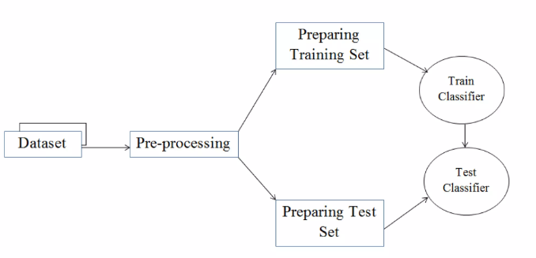
Implementation

Slide 12
Pre-Processing
Tokenization
Unigram: considers only one token
e.g. It is a good movie.
(It, is, a, good, movie}
Bigram: considers two consecutive tokens
e.g. It is not bad movie.
{It is, is not, not bad, bad movie}

Slide 13
Pre-Processing
Stopwords Removal - Common words such as "is", "am", "are", "the" etc. are likely to give no meaning to the text. These words are used just to help the main meaning giving words. Such words are called stopwords.
Text Normalization- Movie reviews are generally a form of casual writing. For example, "good" at times may be written as "goooood", "gud", "gd" etc. All of these words will impart similar meaning but are available in different forms.

Slide 14
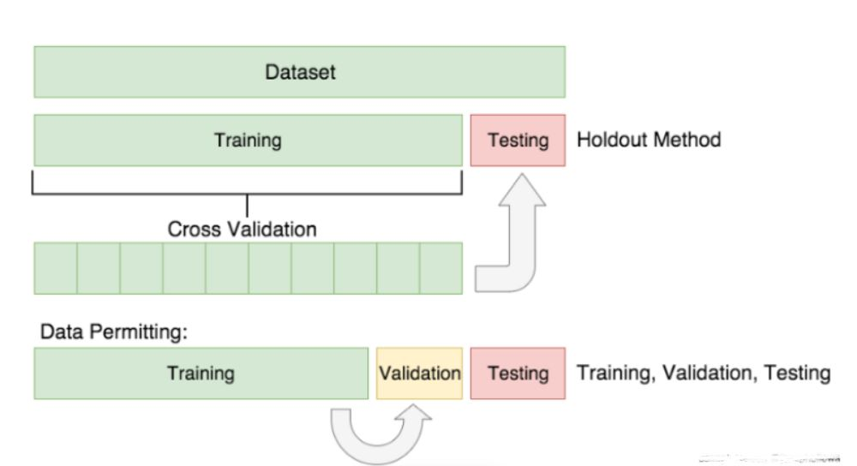
Pre-Processing
Train Test Split
To measure the accuracy of the model we are creating, the data needs to split into 2 parts. A training set to fit and tune our model and a testing set to create predictions on and evaluate the model at the very end.

Slide 15
Accuracy
Algorithms | Data Size | Accuracy
Naive Bayes | 50000 | 0.85=85%
Logistic Regression | 100000 | 0.77=75%

Slide 16
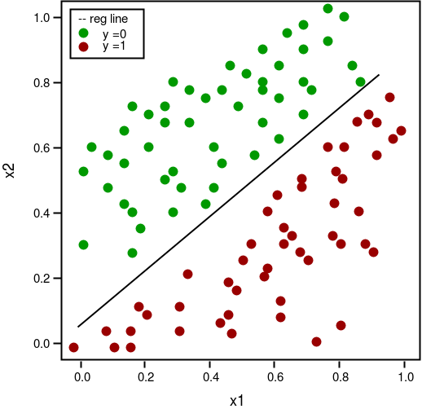
Represents the total(positive, negative) reviews

Slide 17
Advantages
A lower cost than traditional methods of getting movie reviews.
A faster way of getting insight from movie lovers.
The ability to act on viewers suggestions.
Identifies an organization's Strengths, Weaknesses, Opportunities & Threats .
As 80% of all data for a movie review consists of words, the Sentiment Engine is an essential tool for making sense of it all.
More accurate and insightful movie reviews and feedback.

Slide 18
Conclusion
The project's text representation strategy was the bag of words technique.
The two models we used are naive Bayes and logistic regression.
The Naive Bayes classifier with its feature set gives us the best accuracy. Aside from that, we can employ the Logistics Regression Classifier.
We discover that the Navy's Bayes model performs the best, with an accuracy of 0.87. The accuracy for logistic regression is then 0.77

Slide 19
Bibliography
https://www.kaggle.com/datasets/lakshmi25npathi/imdb-dataset-of-50k-movie-reviews
https://web.stanford.edu/~jurafsky/slp3/4.pdf
https://stanfordnlp.github.io/CoreNLP/index.html
https://towardsdatascience.com/text-pre-processing-stop-words-removal-using-different-libraries-f20bac19929a
https://towardsai.net/p/nlp/sentiment-analysis-with-logistic-regression

Slide 20


